Slide 1
Analyzing Risk
Analyze Organizational Risk
Analyze the Business Impact of Risk

Slide 2

Risk Management
The process of identifying risks, analyzing them, developing a response strategy for them, and mitigating their future impact.
Helps prevent or lessen the effects of security incidents.
Four phases
Assessment
Analysis
Response
Mitigation

Slide 3






Components of Risk Analysis
Determine the vulnerabilities that a threat can exploit.
Determine the possibility of damage occurring.
Determine the extent of the potential damage.

Slide 4

Phases of Risk Analysis
Risk analysis: The process used for assessing risk damages that can affect an organization.
1
2
3
Asset ID
Vulnerability ID
Threat Assessment
4
5
6
Probability Quantification
Impact Analysis
Countermeasure Determination

Slide 5
Categories of Threat Types
Threat Category | Description
Natural | Related to weather or other uncontrollable events that are residual occurrences of the activities of nature.
Man-made | Residual occurrences of individual or collective human activity. Can be intentional or unintentional.
System | Related to any weakness or vulnerability found in a network, service, application, or device.

Slide 6
Risk Analysis Methods
Method | Description
Qualitative | Uses descriptions and words to measure the amount and impact of risk, such as High, Medium, and Low. Usually scenario-based. Can be subjective and hard to test.
Quantitative | Based on solely numeric values. Risk data is compared to historic records, experiences, industry best practices, statistical theories, and tests.
Semi-quantitative | Uses descriptions and numeric values. Attempts to find middle ground between qualitative and quantitative risk analysis.

Slide 7
Risk Calculation
SLE: The financial loss expected from a single adverse event.
ALE: The total annual cost of a risk to an organization.
ARO: The number of times per year that a particular loss is expected to occur.
ALE = SLE x ARO
Risk calculation depends on both costs of losses and costs of mitigation.
Vulnerability tables can help document risk calculation factors.
Vulnerability | Identification Source | Risk of Occurrence (1/Low; 5/High) | Impact Estimate (US Dollars) | Mitigation
Flood damage | Physical plant | 5 | $950,000 | Physical adjustments and flood insurance
Electrical failure | Physical plant | 2 | $100,000 | Generator, Uninterruptible power supply (UPS)
Flu epidemic | Personnel | 4 | $200,000 | Flu shots

Slide 8
Risk Response Techniques
Response Technique | Description
Accept | Acknowledgement of the risk and consequences that come with it. Acceptance does not mean leaving a system completely vulnerable. Acceptance is recognizing that the risk involved is not entirely avoidable or the cost of mitigation or avoidance is prohibitive.
Transfer | Allocate the responsibility of risk to another agency, or to a third party, such as an insurance company.
Avoid | Eliminate the risk altogether by eliminating the cause.
Mitigate | Actions to protect against possible attacks. Implemented when the impact of a potential risk is substantial. Active defenses (IDSs), or cautionary measures (backing up at-risk data).

Slide 9
Risk Mitigation and Control Types
Technical controls: Hardware or software installations that are implemented to monitor and prevent threats and attacks to computer systems and services.
Management controls: Procedures that are implemented to monitor the adherence to organizational security policies.
Operational controls: Security measures that are implemented to safeguard all aspects of day-to-day operations, functions, and activities.
Loss/damage controls: Security measures that are implemented to prevent key assets from being damaged.

Slide 10
Change Management
A systematic way of approving and executing change to assure maximum security, stability, and availability of information technology services.
Changes in hardware, software, infrastructure, and documentation can have ripple effects on an organization’s security.
Quantify the costs of training, support, maintenance, and implementation.
Analyze the benefits and complexities of each change.
1
2
3
Analyze
Plan
Implement
Need for change
Change roles
Manage transition phase
Type of change
Change duties
Confirm adoption of change
Organizational culture
Address resistance
Conduct post-project review

Slide 11



Change Management (Cont.)
New service pack fixes several security vulnerabilities for a production server.
Server hosts a custom app that must remain available.
Change management policy requires form approval for all service packs.
The new service pack must be tested on a lab server prior to deployment.
Test results indicate the service pack crashes the custom app.
The custom app must be revised and retested before the service pack is deployed to the production server.
Service Pack
Service Pack

Slide 12
Guidelines for Analyzing Risk
Clearly define organizational expectations for security.
Identify assets requiring protection, and determine their values.
Look for possible vulnerabilities that could adversely affect the organization’s security goals.
Determine possible threats to assets.
Determine the likelihood of the threats exploiting any vulnerabilities.
Determine the threat impact.
Identify the optimal risk analysis method.
Identify possible countermeasures.
Clearly document all findings and decisions.

Slide 13

BIA
A systematic activity that identifies organizational risks and determines their impact on ongoing, business-critical operations and processes.
Vulnerability assessments and evaluations
Determine risks and their effects
Cover all aspects of a business
Can be part of a business continuity plan (BCP)
Prioritization of critical processes
Estimation of tolerable downtime
BIA
Probability of reduced efficiency
Effect of financial loss
Resources needed to restore

Slide 14
Impact Scenarios
Impact | Description
Life | Natural disasters and intentional man-made attacks. Severe weather events Seismic events Arson and other fires Terrorist attack
Property | Natural disasters and intentional man-made attacks: Severe weather events Seismic events Arson and other fires Terrorist attacks Break-ins Equipment damage
Safety | Natural disasters, intentional man-made attacks, and unintentional man-made risks. Severe weather events Seismic events Arson Terrorist attacks Excessive employee illnesses or epidemics

Slide 15
Impact Scenarios (Cont.)
Impact | Description
Finance | Natural disasters, intentional man-made attacks, unintentional man-made risks, and system risks: Severe weather events Seismic events Arson and other fires Terrorist attacks Break-ins Theft Equipment damage File destruction Information disclosure (intentional or inadvertent) User error Social networking and cloud computing Excessive employee illnesses or epidemics Unsecure mobile and networking devices Unstable virtualization environments Email and account-management vulnerabilities

Slide 16
Impact Scenarios (Cont.)
Impact | Description
Reputation | Man-made risks and system risks. Response time for restoration of disrupted services or damaged files Frequent information disclosure Perception of recurring problems Perception of susceptibility Organizational response to risks: Price gouging during natural disasters Response time for addressing information disclosure

Slide 17
Privacy Assessments
Privacy impact assessment (PIA): A tool for identifying and analyzing risks to privacy during the life cycle of a program or system.
Privacy threshold assessment (PTA): A document used to determine when a PIA is required.
Personally identifiable information (PII): Information that a company uses to identify or contact employees and other individuals.
Required for any US agency that collects PII online.
Other regulations might require them for different organizations.

Slide 18




Critical Systems and Functions
Mission-essential
Quantitative comparison
MTD: Maximum tolerable downtime
MTTF: Mean time to failure
MTTR: Mean time to repair/replace
MTBF: Mean time between failures
RTO: Recovery time objective
RPO: Recovery point objective

Slide 19



Maximum Tolerable Downtime
The longest time period that a business outage can occur without causing irrecoverable business failure.
An MTD for each business process.
Can range from minutes, to hours, to days.
Vary by company and event.
Event
MTD
Business Failure
Time

Slide 20
Recovery Point Objective
The longest period of time that an organization can tolerate lost data being unrecoverable.
Usually expressed in hours.
Helps to determine backup frequency.
Longest tolerable time since last backup
RPO
Event
MTD
Time

Slide 21
Recovery Time Objective
The length of time it takes after an event to resume normal business operations and activities.
RPO plus time spent preparing to resume processing.
Must be achieved before MTD.
RPO
Event
RTO
MTD
Time

Slide 22
Mean Time to Failure
The average time that a device or component is expected to be in operation.
Measure of reliability for non-repairable devices and components.
Total hours of operation/number of failures
Event
MTTF
Event
Time

Slide 23
Mean Time to Repair
The average time it takes for a device or component to recover from failure.
Less than RPO when the component is relevant to the recovery effort.
Also referred to as mean time to recover (or replace).
RPO
Event
RTO
MTD
MTTR
Time

Slide 24
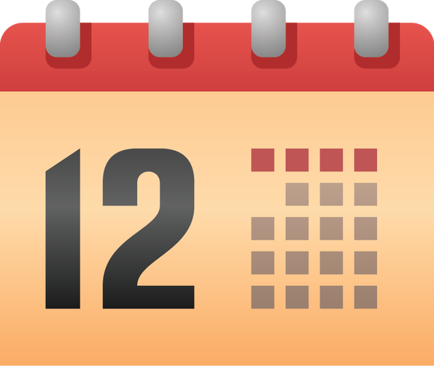

Mean Time Between Failures
The rating on a device or component that predicts the expected time between failures.
Measure of reliability.
Can indicate need for redundancy measures.
MTBF = MTTF + MTTR
Reliability
MTBF

Slide 25
Guidelines for Performing a Business Impact Analysis
Identify mission-essential functions and critical systems.
Identify impact scenarios.
Calculate MTD, RPO, RTO, MTTF, MTTR, and MTBF.
Conduct a privacy threshold assessment and privacy impact assessments when required.
Identify single points of failure.

Slide 26
Reflective Questions
What types of risk does your organization face, and what methods would you use to analyze those risks?
If you were developing a BIA for your organization, what types of systems and functions would you deem essential to operations? Why?

